Slide 1
Enrichment of OBI for Web Services Annotation
ChaitanyaGuttula, AlokDhamanaskar, Yung Long Li, Sunny SuvineethVadlamudi, Rui Wang, John A. Miller, Jessica C. Kissinger University of Georgia
JieZheng, and Christian J. Stoeckert, Jr. University of Pennsylvania

Slide 2
Background
Over 1000 bioinformatics web services
For biological data analysis, typically need more than a single web service
Example:
With a given protein sequence, find its evolutionary relationship to other protein sequences
Bioinformatics programs that need to be used:
BLAST
ClustalW
Phylip
Notes:
Many web services (over 1000) used to invoke bioinformatics programs.

Slide 3
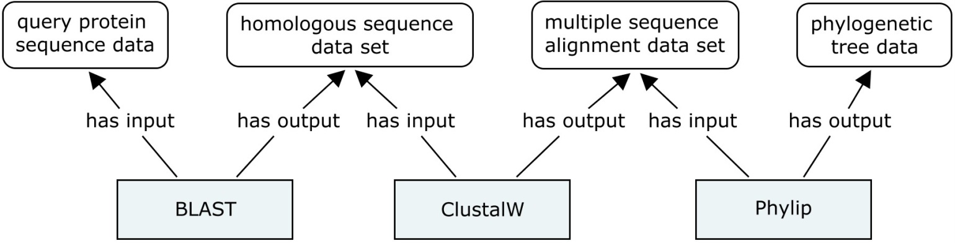
Web Services Workflow Creation
input/output
bioinformatics program
Challenges in workflow creation
Discover the appropriate web service operation to invoke the desired bioinformatics program
Automatic format conversions
output format of one web service operation fit the input format of another web service operation
Semantic annotations can help in automatic web services workflow creation

Slide 4
Semantic Annotation of Web Services
Web Service Description Language (WSDL)
An XML format language to describe the interface of a Web service
Operations offered by a Web service
Details of the operations including input, output, binding, etc.
WSDL-S/SAWSDL
In addition, contain ontology terms to describe web service
Notes:
WSDL-S/SAWSDL
More flexible and easy to use
WSMO, OWL-S/DAML-S, SWSO
Need to represent whole web services call using ontology terms
Web Services Description Language (WSDL) can specify the operations available through a web service and the structure of data sent and received but cannot specify semantic meaning of the data or semantic constraints on the data. This requires programmers to reach specific agreements on the interaction of web services and makes automatic web service composition difficult.
Semantic web services are built around universal standards for the interchange of semantic data, which makes it easy for programmers to combine data from different sources and services without losing meaning.

Slide 5
Main Components of Web Services Annotation
Operation (Execution)
Run BLAST
Functionality
Sequence alignment analysis objective
Inputs
BLAST database, sequence data
Outputs
Alignment results

Slide 6
EDAM
EDAM (EMBRACE Data and Methods) is an ontology of general bioinformatics concepts, including topics and data types, formats, identifiers and operations.
Why not use EDAM?
Not based on BFO
Incompatible with other OBO ontologies due to different organization of classes
Does not contain all the terms and axiomswe need
Fine granularity – need for web service suggestion and discovery
Rich axioms – need for semantic comparison

Slide 7
Enrichment of OBI for Web Services Annotation
Web Service – planned process
Operations
planned process
Functionality
objective specification
Inputs
information content entity, mainly data item
Outputs
information content entity, mainly data item

Slide 8
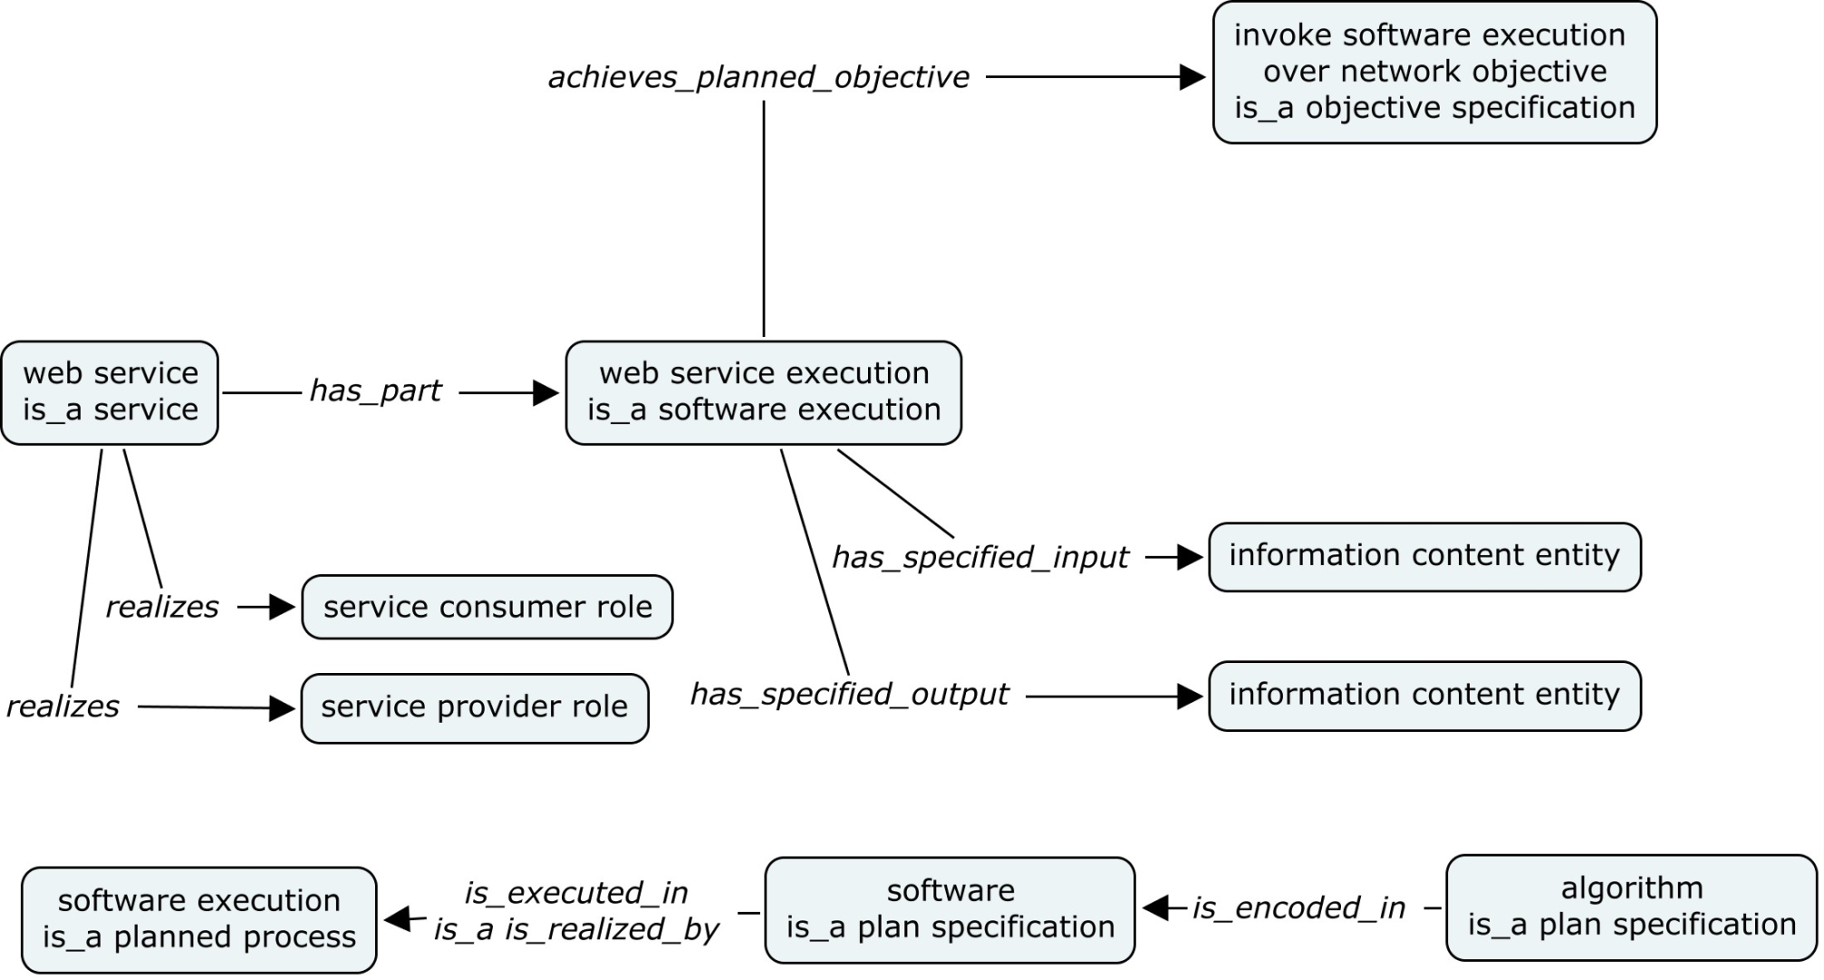
Generic model of Web Services

Slide 9
Definitions of the Terms
Algorithm: a plan specification that contains a set of instructions, independent of implementation and programming languages.
Algorithm is encoded in software, like data item is encoded in data format specification
Relation: ‘is encoded in’, proposed by Software Ontology
We propose its reverse relation as ‘encodes’.
Software: a plan specification that implements (encodes) one or more algorithms in one or more programming languages.
Software execution: a planned process that executes software.
Relation: ‘is executed in’, proposed by Software Ontology
We propose its reverse relation as ‘executes’.

Slide 10
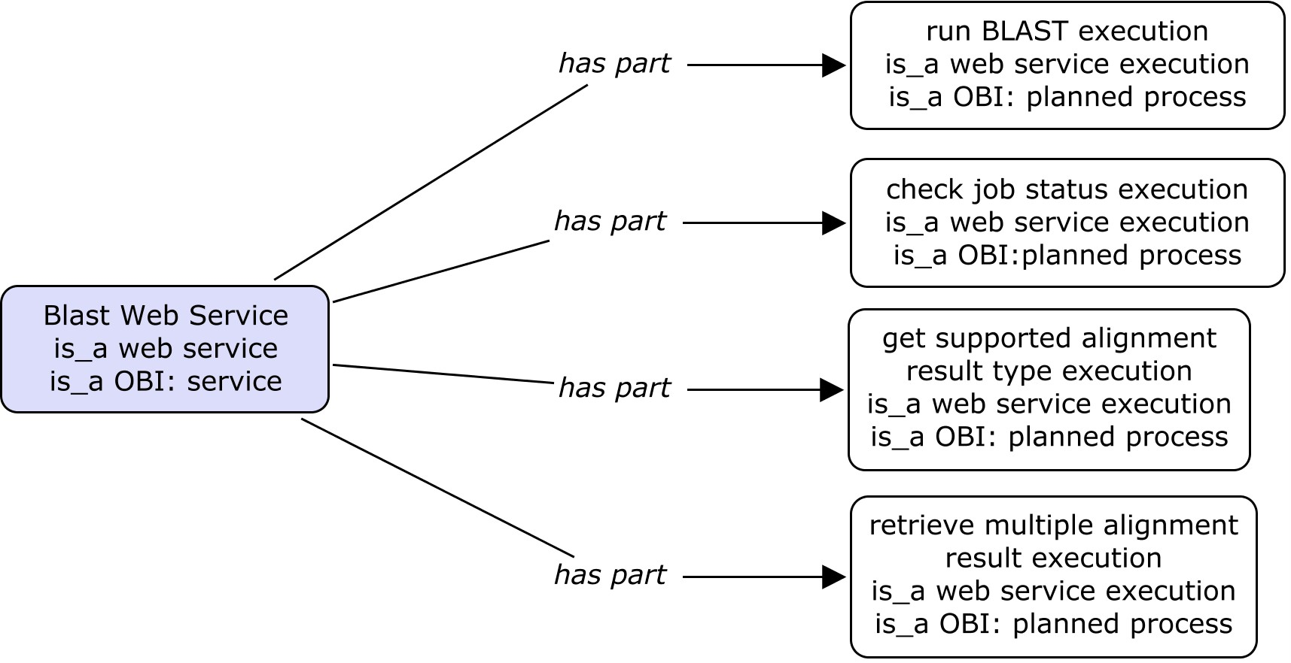
Ontology-based Representation of BLAST web service
Notes:
Will work on it, separate in several viewable figures.

Slide 11
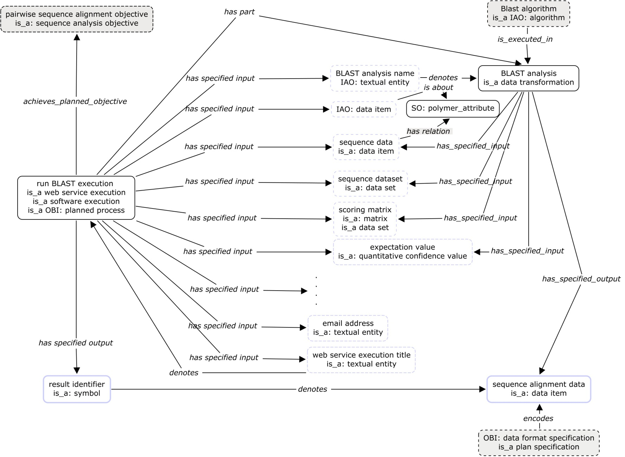
Ontology-based Representation of ‘run BLAST execution’
Notes:
Will work on it, separate in several viewable figures.

Slide 12
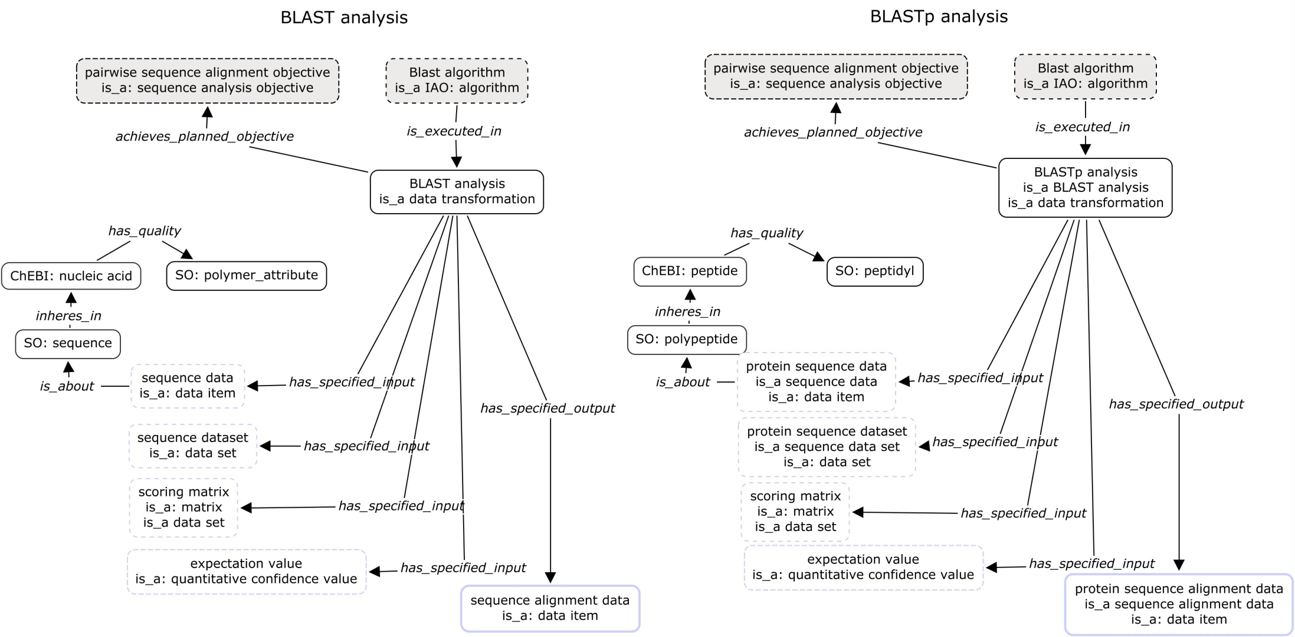
Ontology-based Representation of ‘BLAST analysis’

Slide 13
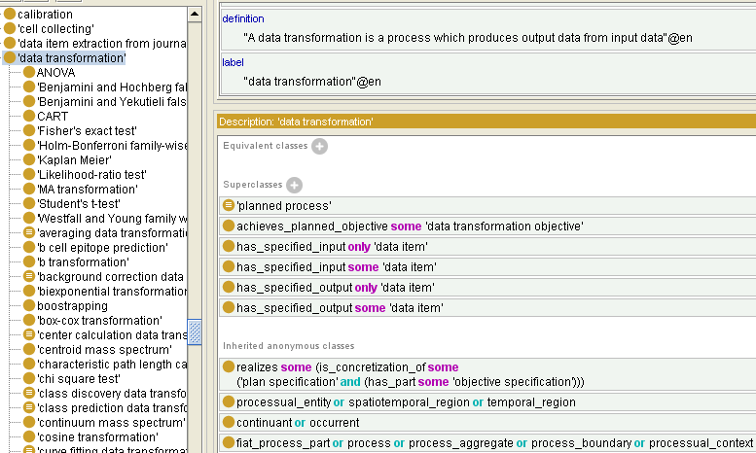
Data transformation
Can we infer some software execution as data transformation?
Why have both has_specified_input only and some ‘data item’?

Slide 14
Terms for Web Services Annotation
OBI Tracker
https://sourceforge.net/tracker/?func=detail&aid=3031357&group_id=177891&atid=886178
Terms for web services annotation added into an OWL file which imported obi.owl
http://webprotege.stanford.edu/#OBI

Slide 15
Current Progress
Have~ 100 terms ready to add
Covering annotation of
BLAST (NCBIBlast, WUBlast , PSI Blast)
Clustal W, T-Coffee
Signal P
Fetch Batch

Slide 16
Compare OBI and EDAM in Web Services Suggestion (example: BLAST to ClustalW)
Case 1
Case 2
Case 3
Case 4
run WUblast
get Result
fetch Batch
run ClustalW
get Result
BLAST
ClustalW
Scores from Suggestion Engine : OBI and EDAM
Notes:
Suggest what?
What case1-4 mean?
What’s the score of no extra annotation
What components are annotated?
Case 1: suggestion score for: getResult operation of WUBLAST Web Service Previous Operation: run WUblast() operation WUBLAST Web Service Case 2: Suggestion score for operation: fetchBatch() of web service WSDBFetch Previous Operation: GetResult of WUBlast Web Service Case 3: Suggestion score for operation run ClustalW() of ClustalW2 Web service Previous operation: fetchBatch() of WSDBFetch web service case 4: Suggestion Score for operation: getResult() of ClustalW2 Web Service Previous operation : run ClustalW() of ClustalW2 Web service

Slide 17
Thank You

Slide 18
Service
planned process‘
(realizes some 'service consumer role') and (realizes some 'service provider role')
Do we need to provide which entity has 'service consumer role‘ and 'service provider role‘ in different service?
eg. web service

Slide 19
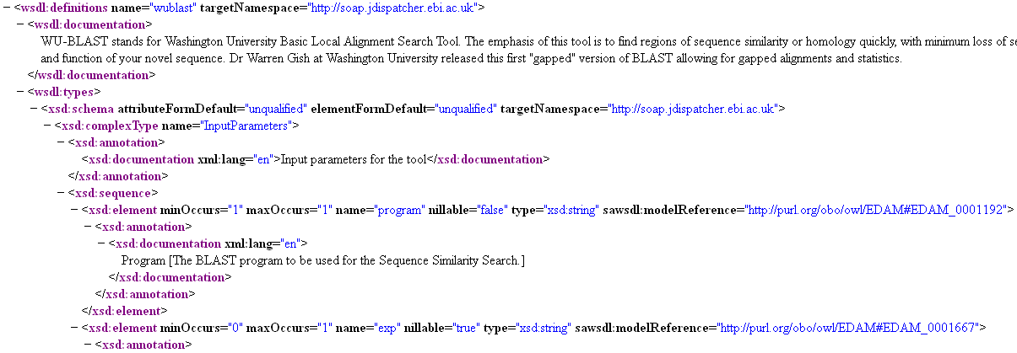
Annotation of WDSL (Example: WU-Blast)
EDAM: 14 terms
(21 operations or parameters)
Notes:
Validate whether annotations using OBI terms help in workflow creation (discovery + suggestion)

Slide 20
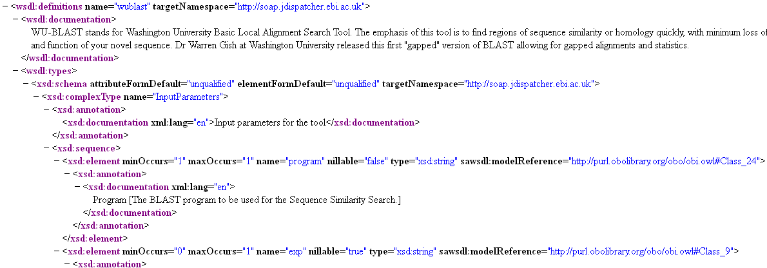
Annotation of WDSL (Example: WU-Blast)
OBI: 28 terms, 25 new terms
(36 operations, objectives or parameters)
Notes:
Validate whether annotations using OBI terms help in workflow creation (discovery + suggestion)

